Slide 1
books database
1
using files and sorted linked list

Slide 2
Team Members
2
Omar Khaled Sayed
Omar Ezzat Mohamed
Omar Mostafa Taha
Mohamed Saied
Al Montaser Bellah Ahmed

Slide 3
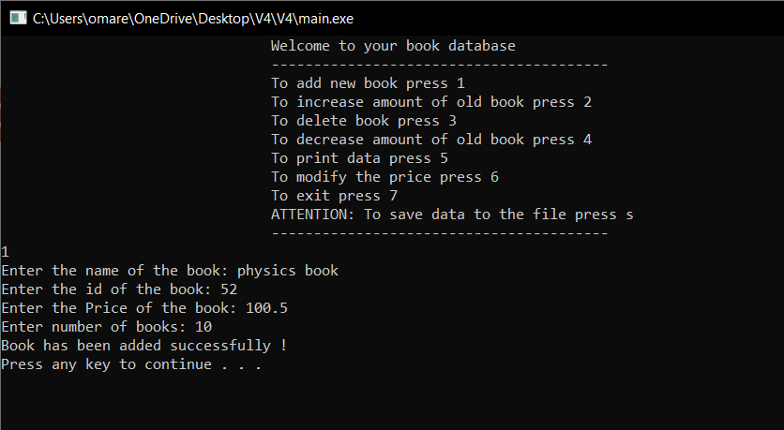
Project description
3

Slide 4
Functions
4
Insert book
Increase number of books
Decrease number of books
Modify price of book
Delete book or all books
Display book or all books
Load and save to files

Slide 5
First of all
5
typedef struct listnode ListNode;
typedef long long int lli;
struct listnode
{
lli id;
char name [25];
float price;
int nbook;
ListNode *next;
};
typedef struct list
{
ListNode *head;
int size;
}List;

Slide 6
Create List
6
CreateList(&l);
L
Size=0
void CreateList(List *pl)
{
pl->head=NULL;
pl->size=0;
//O(1)
}
NULL

Slide 7
Insert Book
7
bool InsertList(List *pl,lli id,char n[],float p,int x)
{
ListNode *pn= (ListNode*)malloc(sizeof( ListNode));
pn->next=NULL;
pn->id=id;
pn->price=p;
strcpy(pn->name,n);
pn->nbook=x;
ListNode *qn=pl->head;
while(qn)
{
if(qn->id == id)
{ printf("ID is already taken, try another ID...\n");
return false;}
qn=qn->next;}
L
Size=1
A
*|data
NULL

Slide 8
Insert Book
8
if(pl->head==NULL || pl->head->id > id)
{
pn->next=pl->head;
pl->head=pn;
}
else
{
ListNode *temp=pl->head;
while (temp->next !=NULL && temp->next->id < id)
{
temp=temp->next;
}
pn->next=temp->next;
temp->next=pn;
}
pl->size++;
return true;
//O(N)
}
L
Size=2
B
*|data
A
*|data
NULL

Slide 9
Delete List By ID
10
L
Size=1
void DeleteListID(List *pl,lli id)
{ ListNode *a,*b;
a=pl->head;
if(!a)
{ printf("List empty !\n");
return 0; }
else
{ if(a->id==id)
{ pl->head=a->next;
free(a);
pl->size--;
printf("Book deleted successfully !\n");
return 0;}
A
Deleted
NULL

Slide 10
Delete List By ID
L
Size=3
11
else
{ a=a->next;
b=pl->head;
while(a)
{ if(a->id!=id)
{ a=a->next;
b=b->next; }
else if(a->id!=id)
break;}
if(!a) {printf("ID not found!\n"); return 0;}
else if(a->id==id)
{ b->next=a->next;
free(a);
pl->size--;}}}
SaveData(pl);}
B
*|data
C
deleted
A
*|data
NULL

Slide 11
Increase By ID
12
L
Size=1
void IncreaseByID(List *pl,lli id,int x)
{ ListNode *pn=pl->head;
if(!pn){ printf("Empty Database !\n");
return0;}
else
{while(pn)
{if(pn->id==id)
{pn->nbook+=x;
printf("Book increased successfully !\n");
return 0;}
pn=pn->next;}}
if(!pn)
printf("ID not found !\n");}
B
Book+=x
NULL

Slide 12
Increase By Name
13
L
Size=1
void IncreaseByName(List *pl,char name[],int x)
{ ListNode *pn=pl->head;
if(!pn){ printf("Empty Database !\n");
return0;}
else
{while(pn)
{if(strcmp(pn->name,name)==0)
{ pn->nbook+=x;
printf("Book increased successfully !\n");
return 0; }
pn=pn->next; }
if(!pn)
printf("Name not found !\n");}}
B
Book+=x
NULL

Slide 13
Decrease By ID
14
void decreaseByID(List *pl,lli id,int x)
{ ListNode *pn=pl->head;
if(!pn){ printf("Empty Database !\n");
return0;}
else
{while(pn)
{if(pn->id==id)
break;
pn=pn->next;}
if(pn==NULL) printf("ID not found !\n");
else
{ if(pn->nbook>=x)
{pn->nbook-=x;
printf("Book decreased successfully !\n");}
else
{printf("You don't have enough books\nYou only have %d\n",pn->nbook);}}}}
L
Size=1
B
Book - =x
NULL

Slide 14
Decrease By Name
15
void decreaseByName(List *pl,char name[],int x)
{ ListNode *pn=pl->head;
if(!pn){ printf("Empty Database !\n");
return0;}
else
{while(pn)
{ if(strcmp(pn->name,name)==0)
break;
pn=pn->next;}
if(pn==NULL) printf("Name not found !\n");
else
{ if(pn->nbook>=x)
{ pn->nbook-=x;
printf("Book decreased successfully !\n");}
else
{ printf("You don't have enough books\nYou only have %d\n",pn->nbook); }}}}
L
Size=1
B
Book - =x
NULL

Slide 15
Destory List
16
void DestoryList(List *pl)
{ ListNode *q;
if(pl->head==NULL)
{ printf("Database is empty !\n");
return 0; }
else
{ while(pl->head)
{ q=pl->head->next;
free(pl->head);
pl->head=q;}
pl->size=0;
printf("Data deleted successfully !\n");}
}//O(N)

Slide 16
Modify Price By ID
17
L
Size=1
void ModifyPriceID(List *pl,lli id,float y)
{ ListNode *qn=pl->head;
if(qn==NULL) printf("Empty Database !\n");
else
{while(qn)
{if(qn->id==id)
{qn->price=y;
printf("Book modified\n");
return 0;}
qn=qn->next;}
if(!qn)
printf("Book not found !\n");}
}//O(N)
B
Price = new
NULL

Slide 17
Modify Price By Name
18
L
Size=1
void ModifyPriceName(List *pl,char n[],float p)
{ ListNode *qn=pl->head;
if(qn==NULL) printf("Empty Database !\n");
else
{while(qn)
{if(strcmp(qn->name,n)==0)
{ qn->price=p;
printf("Book modified\n");
return 0;}
qn=qn->next;}
if(!qn)
printf("Book not found !\n");}
}//O(N)
B
Price = new
NULL

Slide 18
Display
19
void Display(char name[],lli id,float p,int n)
{
printf("---------------------------------------\n");
printf("Book name: ");
puts(name);
printf("\nID: %lld\nPrice: %.2f\nNumber of same book: %d\n",id,p,n);
printf("---------------------------------------\n");
//O(1)
}

Slide 19
Display Single Book
20
void RetriveList(List *pl,lli id)
{ ListNode *qn=pl->head;
if(qn==NULL) printf(“Empty Database !\n");
else
{ while(qn)
{if(qn->id==id)
{Display(qn->name,qn->id,qn->price,qn->nbook);
return 0;}
qn=qn->next;}
if(!qn)
printf("Book not found");}
}//O(N)

Slide 20
Display all Books
21
void TraverseList(List *pl)
{
if(pl->head==NULL)
printf("-------------\nThere's no book in your database\n--------------\n");
else
{
printf("Number of Different books: %d\n\n",pl->size);
int i=1;
for(ListNode *ln=pl->head;ln;ln=ln->next)
{ printf("Book number %d:\n",i++);
Display(ln->name,ln->id,ln->price,ln->nbook);
}}}//O(N)

Slide 21
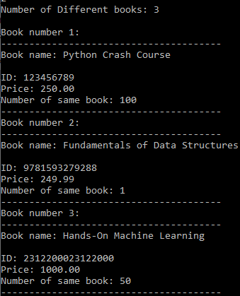
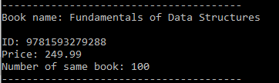
Display Example
22
Display single book using void RetriveList(List *pl,lli id) | Display all Books using void TraverseList(List *pl,void (*pf)(char name[],lli id,float p,int n))

Slide 22
Save Data to file
23
FILE *f_open;
struct temps
{
lli id;
char name [40];
float price;
int nbook;
}t1;
void SaveData(List *pl)
{
ListNode *pn;
if(!(f_open=fopen(“file.dat","wb")))
{ printf("Can't open The file\n");
return 0;}
else
{ for(pn=pl->head;pn;pn=pn->next)
{ t1.id=pn->id;
strcpy(t1.name,pn->name);
t1.price=pn->price;
t1.nbook=pn->nbook;
fwrite(&t1,sizeof(t1),1,f_open);}}
fclose(f_open);
return 0;}

Slide 23
Load Data from file
24
void LoadData(List *pl)
{
while(fread(&t1,sizeof(t1),1,f_open))
{
InsertList(pl,t1.id,t1.name,t1.price,t1.nbook);
}
fclose(f_open);
}

Slide 24
Getting Started to main
25
char gettingStarted()
{ char c;
printf("To add new book press 1\n");
printf("To increase amount of old book press 2\n");
printf("To delete book press 3\n");
printf("To decrease amount of old book press 4\n");
printf("To print data press 5\n");
printf("To modify the price press 6\n");
printf("To exit press 7\n");
printf("ATTENTION: To save data to the file press s\n");
fflush(stdin);
scanf("%c",&c);
return c;}

Slide 25
Main
26
int main()
{
char sw;
List l;
CreateList(&l);
printf("\t\t\t\tWelcome to your book database\n");
system("pause");
sw=gettingStarted();
if(f_open=fopen(“file.dat","rb"))
LoadData(&l);
while (1<2)
{lli id ;
float price;
char name[40];
int temp,amount,x;
switch (sw)
{

Slide 26
Insert Book
27
case '1':
{
printf("Enter the name of the book: ");
fflush(stdin);
gets(name);
fflush(stdin);
printf("Enter the id of the book: ");
scanf("%lld",&id);
printf("Enter the Price of the book: ");
scanf("%f",&price);
printf("Enter number of books: ");
scanf("%d",&x);
bool isSuccess = InsertList(&l , id , name , price , x);
if (isSuccess){
printf("Book has been added successfully !\n");
}
break;
}

Slide 27
Increase number of same book
28
case '2':
{
printf("To increase by id press 1\nto increase by name press 2\n ");
scanf("%d",&temp);
if(temp==1)
{
lli idd;
printf("Please enter the id of the book: ");
scanf("%lld",&idd);
printf("Enter the amount of books to be increased: ");
scanf("%d",&amount);
IncreaseByID(&l,idd,amount);
}

Slide 28
else if(temp==2)
{
printf("Please enter the name of the book: ");
fflush(stdin);
gets(name);
fflush(stdin);
printf("Enter the amount of books to be increased: ");
scanf("%d",&amount);
fflush(stdin);
IncreaseByName(&l,name,amount);
}
else
printf("Wrong answer\n");
break;
}
29

Slide 29
Delete book or all books
30
case '3':
{
char q;
printf("To delete a single book press 1\nTo destroy all database press 2: ");
scanf("%d",&temp);
if(temp==1)
{
printf("Enter the id of the book: ");
scanf("%lld",&id);
DeleteListID(&l,id);
break;
}

Slide 30
else if(temp==2)
{
printf("Are you sure you want to destroy all database? [y/n]\n");
fflush(stdin);
scanf("%c",&q);
if(q=='y'||q=='Y')
{
DestoryList(&l);
SaveData(&l);
break; }
else
break; }
else
{
printf("Wrong answer !\n");
break; }}
31

Slide 31
Decrease number of same book
32
case '4':
{printf("To decrease by id press 1 \nTo decrease by name press 2 \n");
scanf("%d",&temp);
if(temp==1)
{
printf("Enter the id: ");
scanf("%lld",&id);
printf("Enter the amount to be decreased: ");
scanf("%lld",&amount);
decreaseByID(&l,id,amount);}

Slide 32
else if(temp==2)
{
printf("Enter the name: ");
fflush(stdin);
gets(name);
fflush(stdin);
printf("Enter the amount to be decreased: ");
scanf("%lld",&amount);
decreaseByName(&l,name,amount);
}
else
printf("Wrong answer\n");
break;
}
33

Slide 33
Print Single book or all books
34
case '5':
{
printf("To print single book press 1\nTo print all books press 2\n");
scanf("%d",&temp);
if(temp==1)
{
printf("Enter the id of the book: ");
scanf("%lld",&id);
RetriveList(&l,id);
}
else if(temp==2)
TraverseList(&l,Display);
else printf("Wrong answer !\n");
break;
}

Slide 34
Modify price of book
35
case '6':
{
printf("To modify by id press 1\nTo modify by name press 2\n");
scanf("%d",&temp);
if(temp==1)
{
float pp;
printf("Enter the id of the book: ");
scanf("%lld",&id);
printf("Enter the new price: ");
scanf("%f",&pp);
ModifyPriceID(&l,id,pp);
}

Slide 35
else if(temp==2)
{
float pp;
printf("Enter the name of the book: ");
fflush(stdin);
gets(name);
fflush(stdin);
printf("Enter the new price: ");
scanf("%f",&pp);
ModifyPriceName(&l,name,pp);
}
else
printf("Wrong answer !\n");
break;
}
36

Slide 36
End of main
37
case '7':
{
printf("\t\t\t\t\t\tGoodBye<3\n\n\n");
exit(1);}
case 's':
{
SaveData(&l);
printf("\nData saved !\n");
break;}
default:
{ printf("Wrong answer\n");}}
system("pause");
system("cls");
sw= gettingStarted();}}

Slide 37
Good Bye
38

